Slide 1
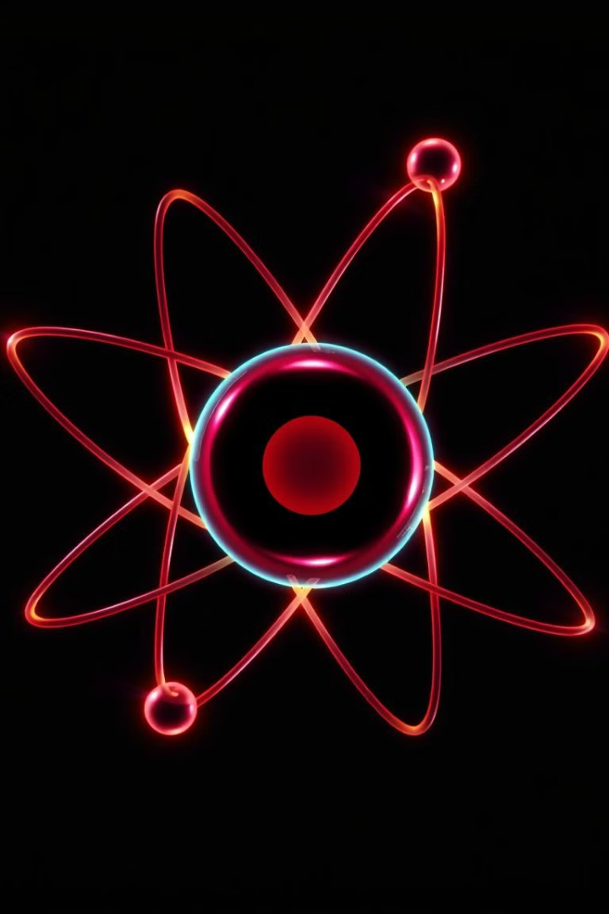
Atomic Structure Simulation
An interactive 3D visualization tool for exploring electron orbits in atomic structures. Created by Jeevan E G and Pranav P Kulkarni for Computer Graphics coursework at RV University.
by Jeevan EG
Pranav P Kulkarni

Slide 2




Project Overview
Educational Tool
OpenGL Implementation
Interactive Features
Visualizes atomic structure of first ten elements (Hydrogen to Neon)
Built using OpenGL and GLUT libraries
Select elements, start/stop animations, mouse and keyboard controls

Slide 3
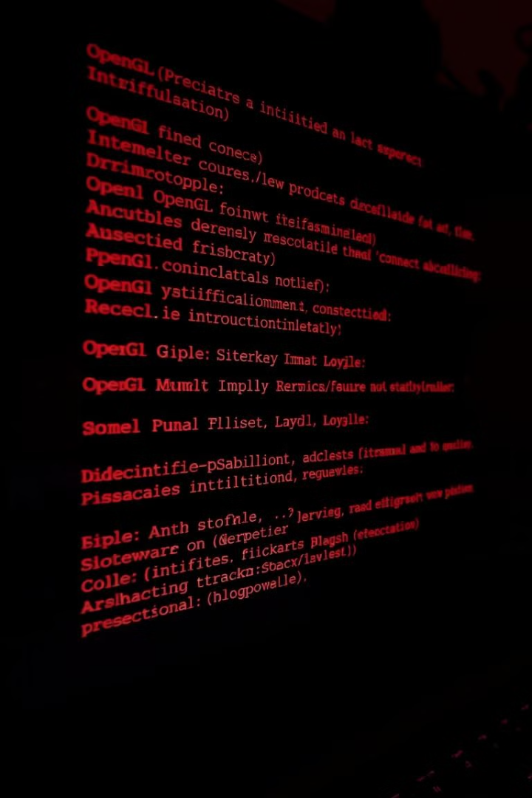




Initialization & Setup
GLUT Initialization
Initialize library, process command line arguments
Window Configuration
Set position (100,100) and size (700x700)
Graphics Setup
Establish coordinate system (-1000 to 1000)
Create Window
Display "ATOM SIMULATION" title

Slide 4

Drawing Functions
Basic Commands
Color Setting
glBegin/glEnd
glClearColor
glVertex2i/glVertex2f
glColor3f
Text Rendering
glRasterPos3f
glutBitmapCharacter

Slide 5








Transformation & Animation
Save State
Apply Rotation
glPushMatrix() stores current transformation
glRotatef() animates orbiting electrons
Redisplay
Restore State
glutPostRedisplay() triggers next frame
glPopMatrix() returns to previous state

Slide 6



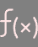

User Interaction
Mouse Control
glutMouseFunc() handles clicks and menu selection
Keyboard Input
glutKeyboardFunc() processes regular keys
Special Keys
glutSpecialFunc() manages function keys
Menu System
Right-click menus for element selection

Slide 7



Element Visualization
Draw Nucleus
Central blue circle using GL_POLYGON
Create Orbits
K shell (radius 400) and L shell (radius 600)
Position Electrons
Place electrons based on element configuration

Slide 8
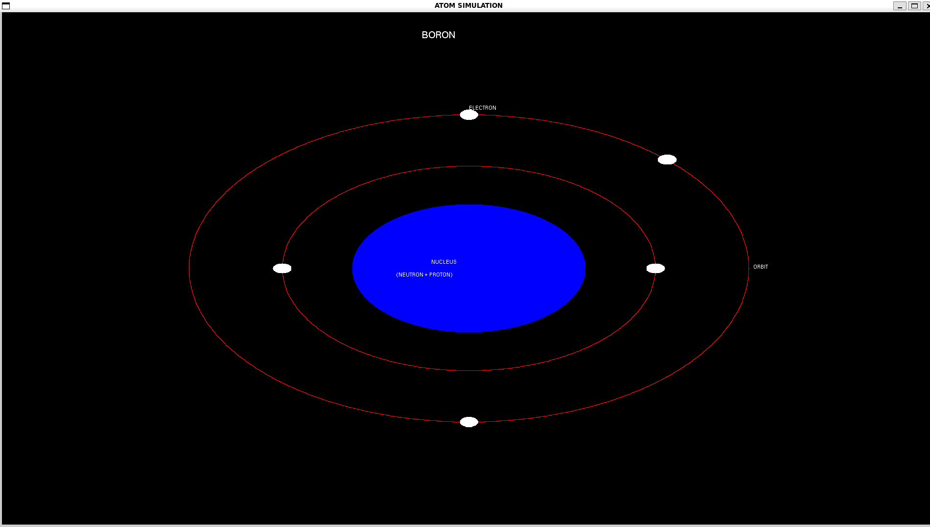
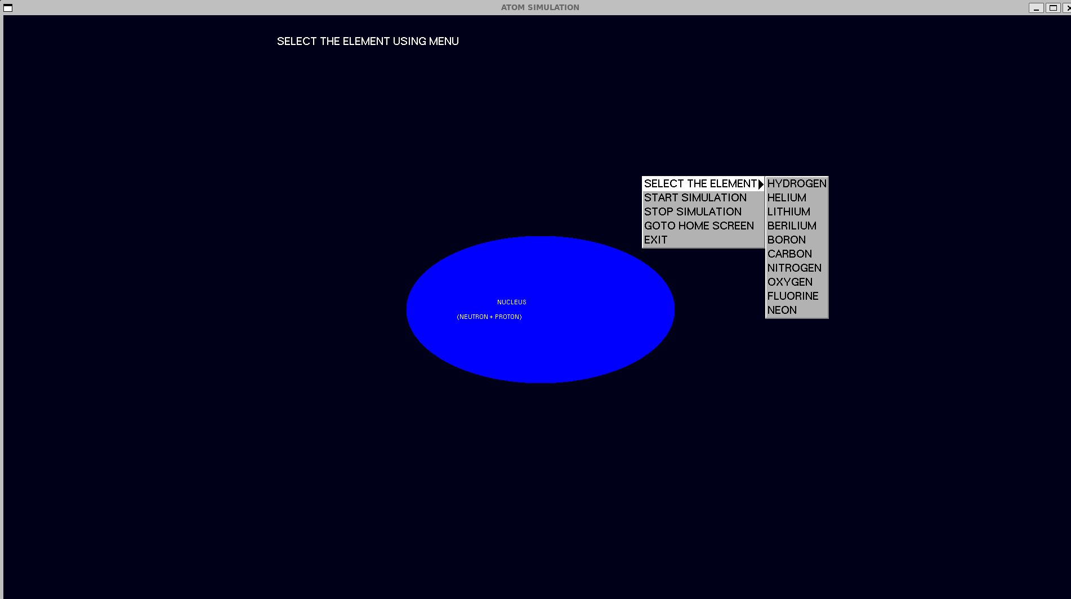
Project Outcome

